Slide 1
Introduction to Deep Learning
By Pooya Darvehei

Slide 2
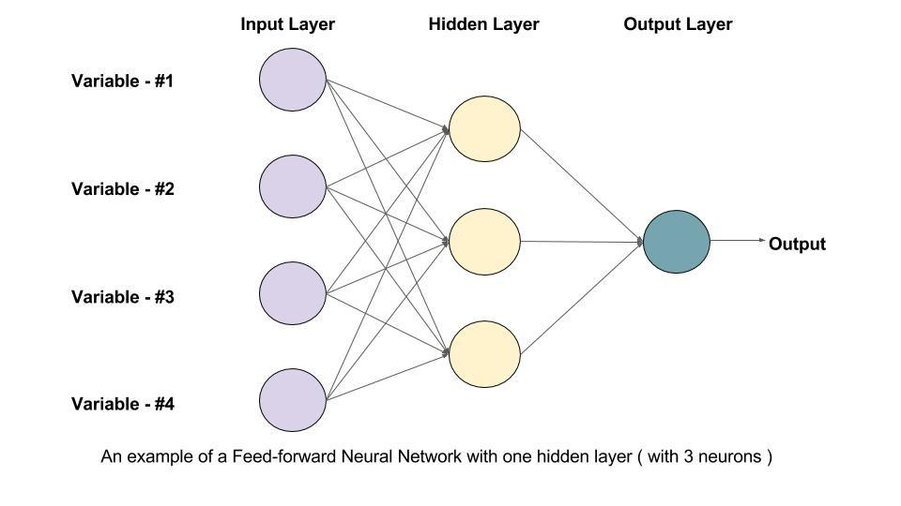
Artificial Neural Networks (ANN)
Inspired by biological neural networks.
The circles are called Neurons.
The arrows are called connections.
Each column of Neurons is called a layer.
Every Connection and Neuron represents a value.

Slide 3
Artificial Neural Networks (ANN)
The value in a Neuron is multiplied by the value of the Connection.
The output of all the connections that enter a Neuron is summed up.
An extra value (biase) is added to the summation.
The result is passed through an activation function.

Slide 4
Artificial Neural Networks (ANN)
f(W×X+B)=Y
X: Input values
Y: Output
W: Connection values (weights)
B: Biase
f: Activation function

Slide 5
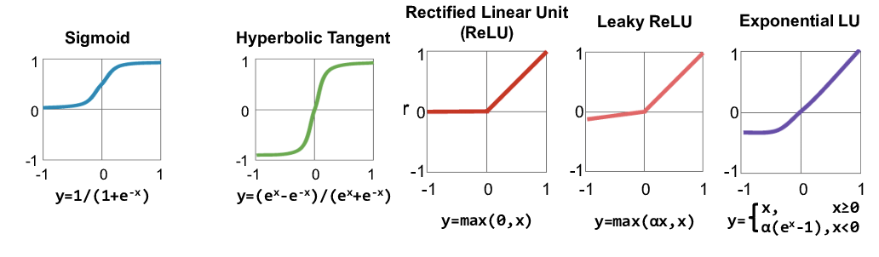
Activation Function

Slide 6
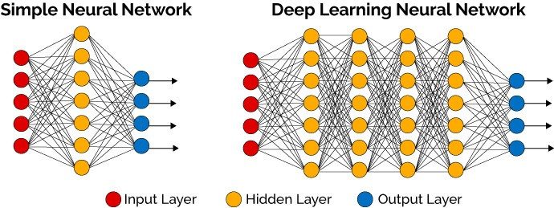
Deep Neural Networks (DNN)

Slide 7
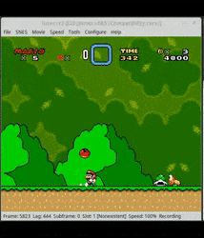
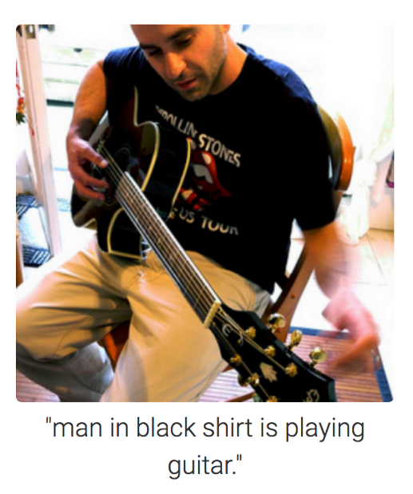
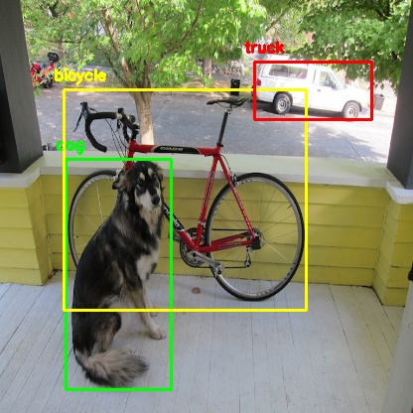
Applications
Tabular data
Computer Vision
Natural Language Processing
Time Series
Reinforcement Learning
Generative models

Slide 8
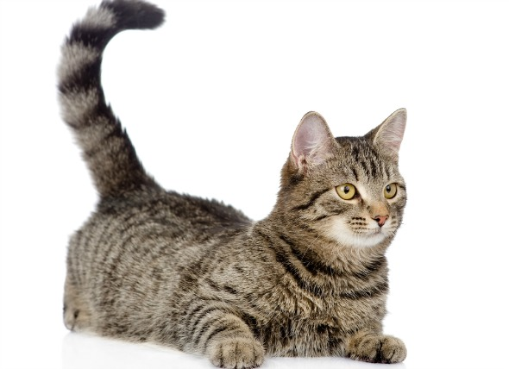
Computer Vision
We want to know the main subject in an image. How can a model do that?
This is one of the first problems computer vision had to deal with.
Image Classification

Slide 9
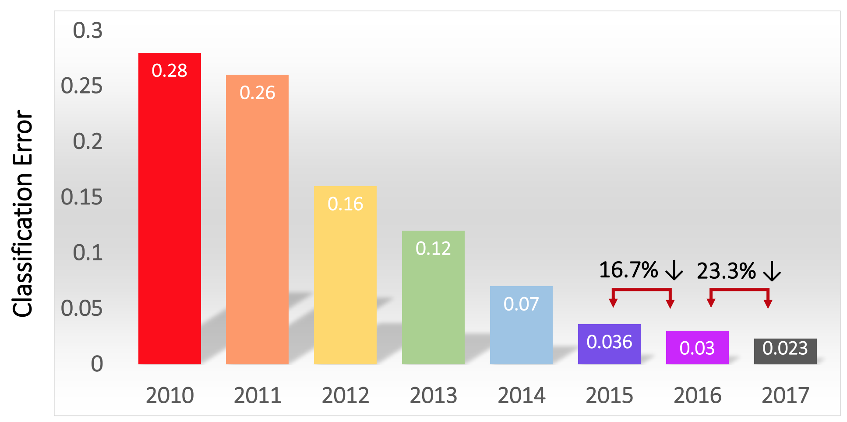
ImageNet Challenge
The goal is to successfully predict the object inside images. They used 1.4 million images of 1000 categories.
In 2012, a deep learning model called AlexNet won the competition.
In 2015, ResNet by Microsoft won the competition beating human performance.

Slide 10
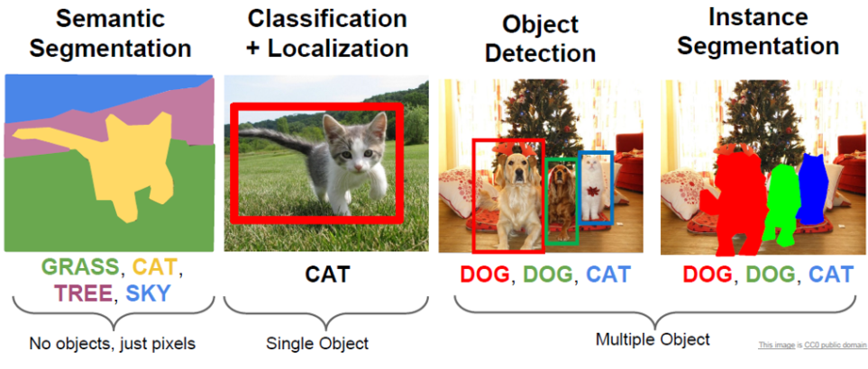
Computer Vision

Slide 11

Semantic Segmentation
Classifying the pixels of an image
Common architecture:
U-net
Advantage:
High accuracy in location of the object
Disadvantage:
Can’t identify the number of objects

Slide 12
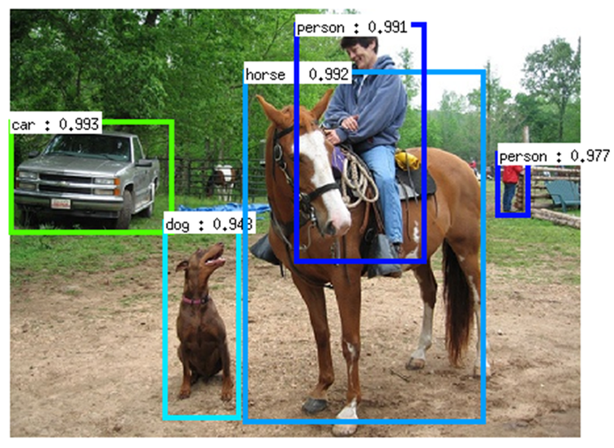
Object Detection
Locate and classify the objects and draw a bounding box around them.
Common Architectures:
SSD
Faster R-CNN
YOLO
Advantage:
Locate the object
Can detect multiple objects of the same type
Disadvantage:
Does not have pixel-level classification

Slide 13
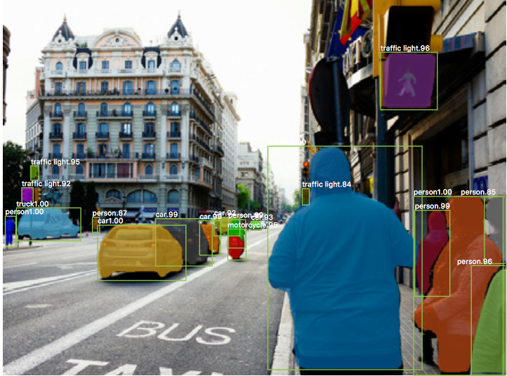
Instance Segmentation
Locates and classifies every instance of an object and creates a pixel-level classification mask
Common Architecture:
Mask R-CNN
Advantage:
Can identify multiple objects of the same class
Does pixel classification for each instance
Disadvantage:
Slow in training and inference

Slide 14
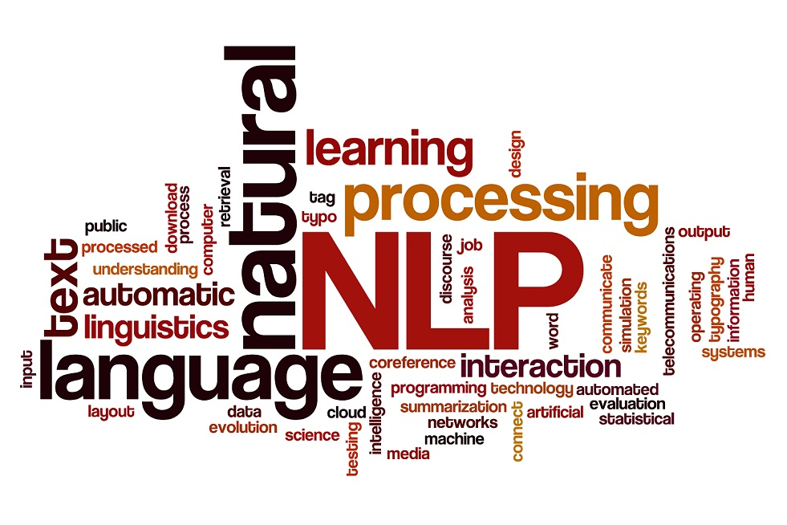
Natural Language Processing (NLP)
Sentiment Analysis
Is this review good or bad?
Topic Segmentation
What is the topic of this article?
Machine Translation
Translating from one language to another
Question Answering
Chatbots
Text Summarisation
Text Similarity
Checking for plagiarism

Slide 15
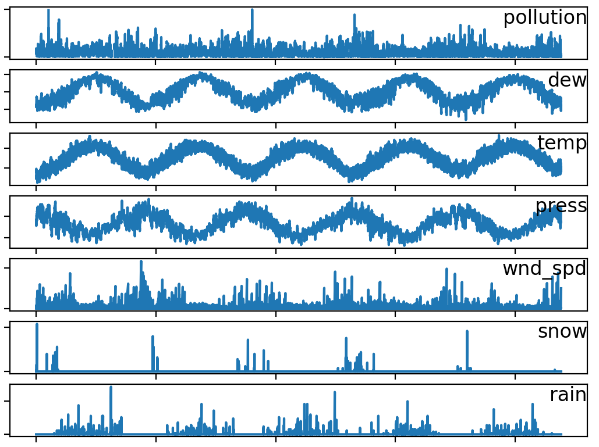
Time Series
Economic Forecasting
What’s the inflation rate next year?
Weather Forecasting
What’s the probability of tomorrow raining?
Inventory Analysis
How much of this item do I need to stock?
Sales Forecasting
What is the sales going to be like next week?
Anything that changes with time

Slide 16

Reinforcement Learning
It’s neither Supervised nor Unsupervised learning
Agent learns by interacting with the environment.
It gets rewarded when the goal is achieved.
The agent learns by experience.

Slide 17
Generative Adversarial Networks
It has two main components:
Generator
Discriminator
Generator creates an item (photo, text, audio)
Discriminator tries to tell whether the item it receives is fake (generated)

Slide 18
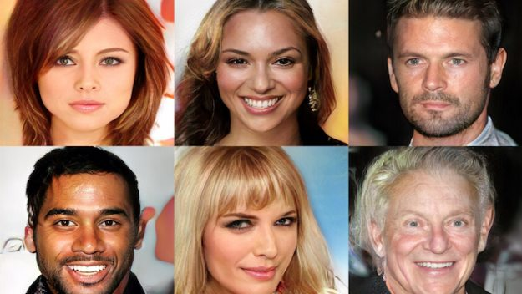
Generative Adversarial Networks

Slide 19
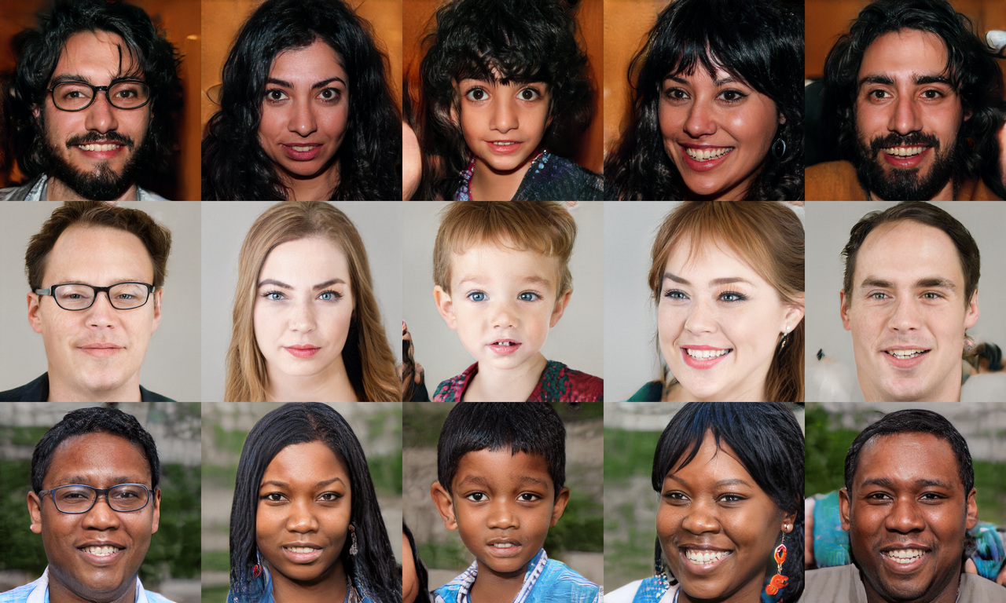
Generative Adversarial Networks

Slide 20
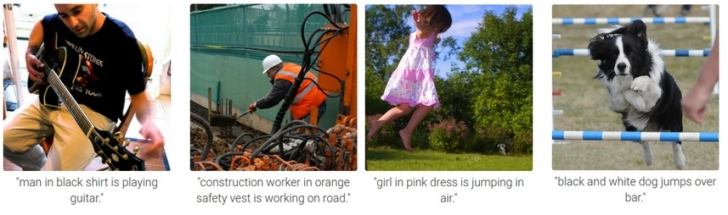
Image Captioning

Slide 21
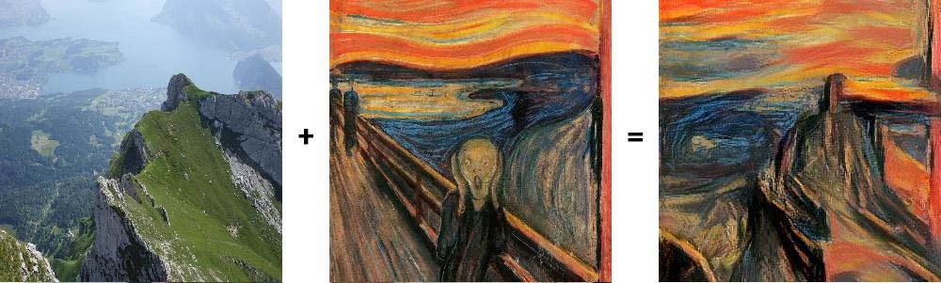
Style Transfer

Slide 22
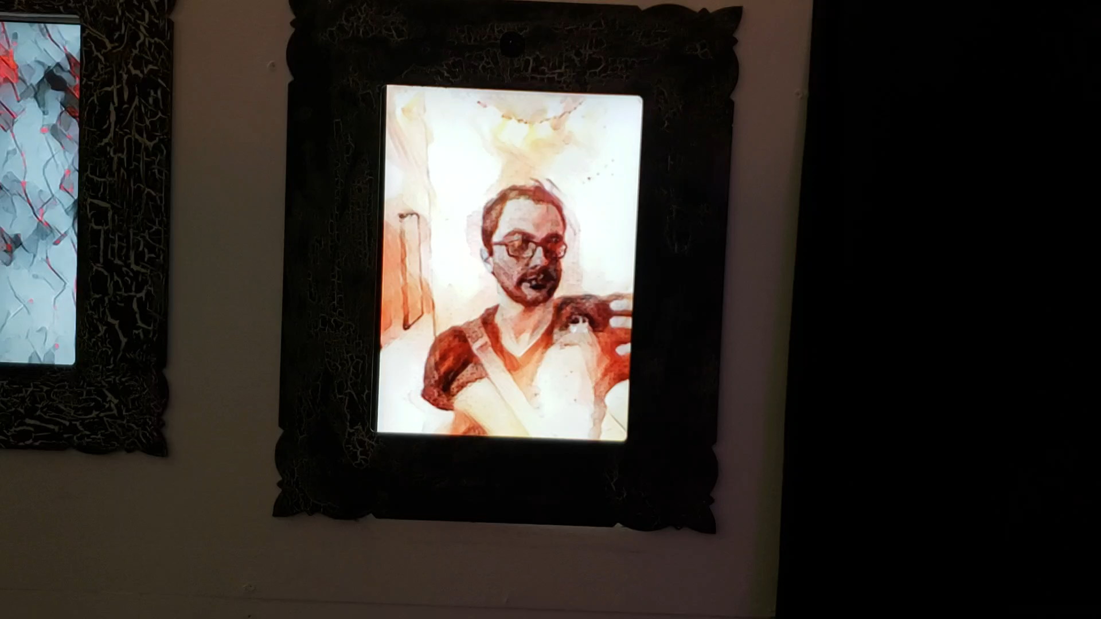

Slide 23
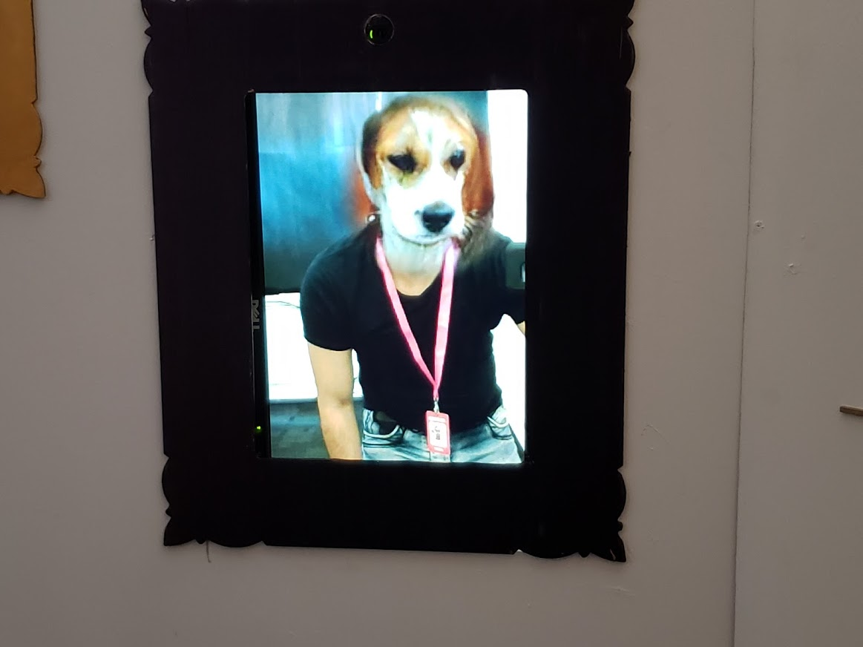

Slide 24
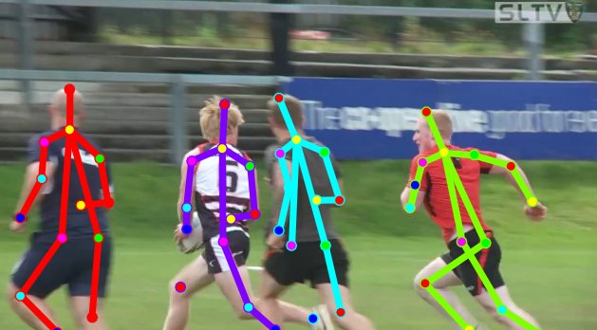
Pose Estimation

Slide 25
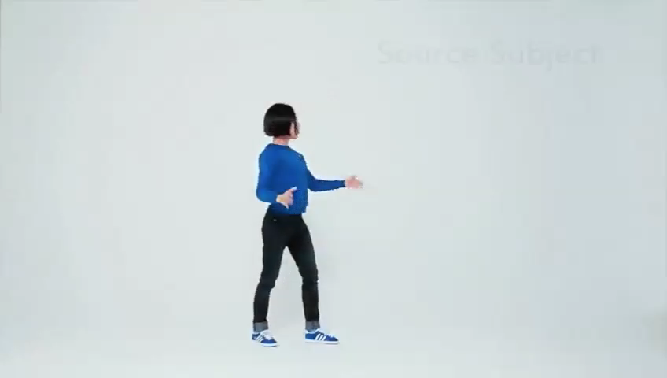
Everybody Dance Now

Slide 26
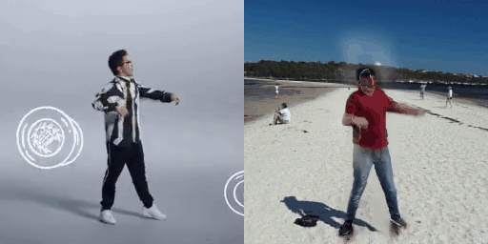

Slide 27
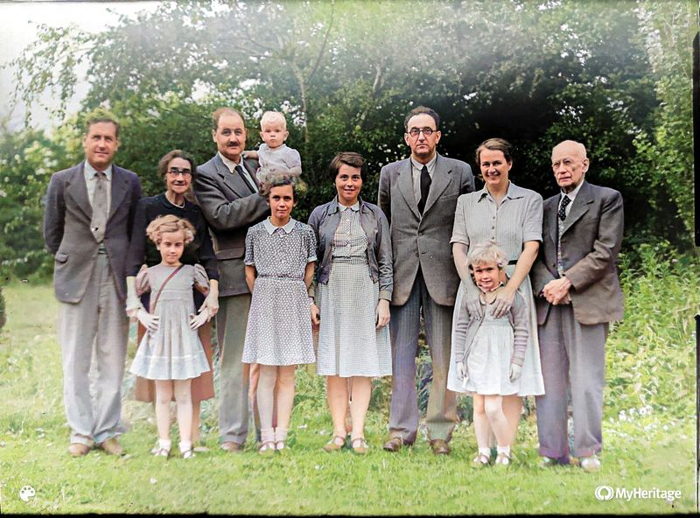
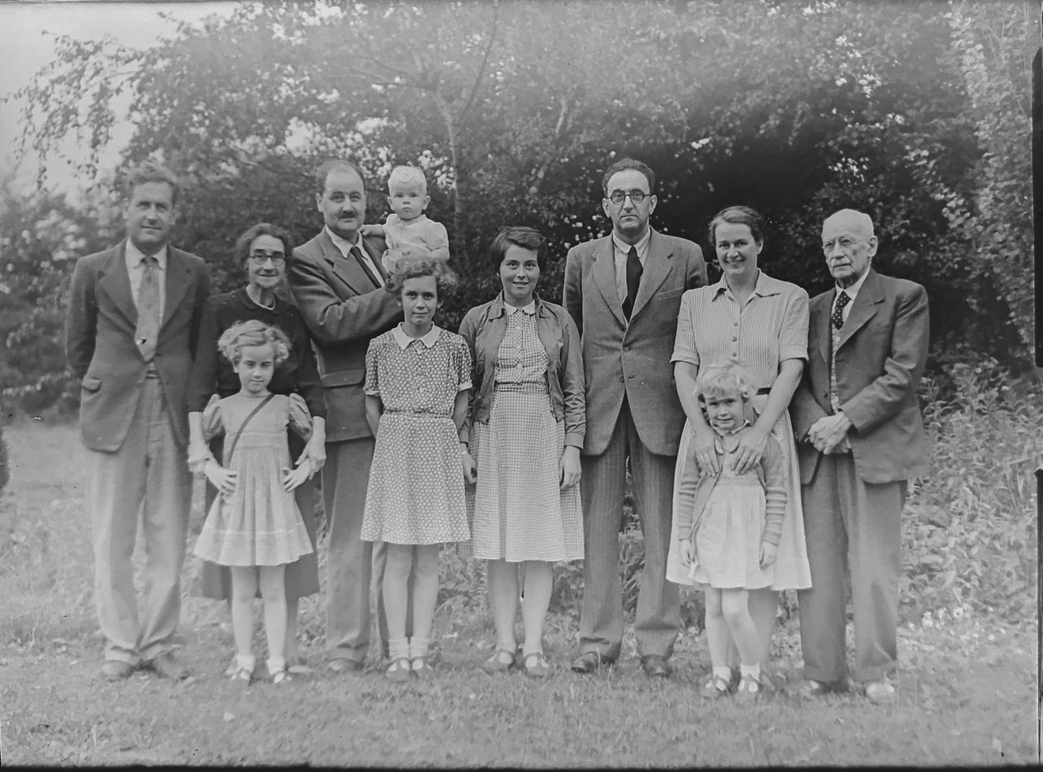
Image colourisation

Slide 28
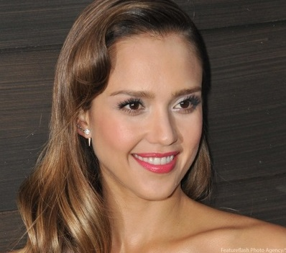

Selfie2anime

Slide 29
Demo
GauGAN Photo Generator
Image Inpainitng
These cats do not exist
Text Generation
DeepArt.io Style Transfer

